Slide 1
Bike Sharing Assignment
Nishad purohit
Nishad.purohit20@gmail.com

Slide 2
Task 2
The work that we have performed in this task were as follows.
What are the top 10 least popular stations? Hint: Find the least frequently appearing start stations from the Trip table.
Find the idle time for Station 2 on the date '2013/08/29’
Find the distance between consecutive stations
From these we can have insights on the following information

Slide 3
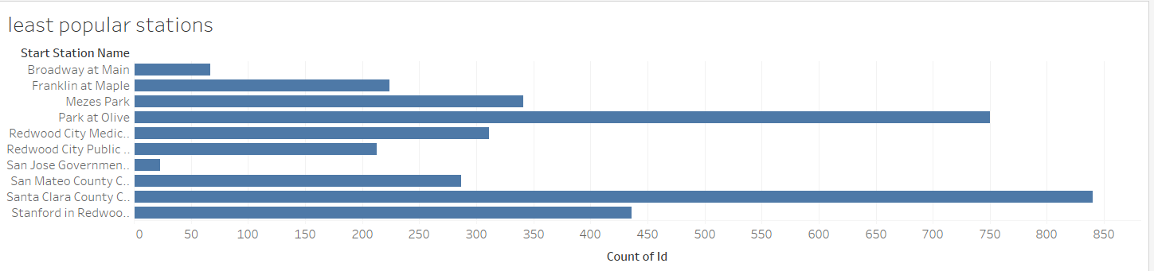
Least popular stations
Here are the top 10 least popular stations. The least here as we can see is San Jose government followed by broadway to main and so on.

Slide 4
Conclusion(Task 2)
The three stations that we can shut down are the Broadway at main, San Jose government and Franklin at Maple as these are the least popular stations. Another reason to shut down these stations is because there are other stations which are close to these three stations and are preferred more by both consumers and subscribers.

Slide 5
Task 4
The question that we are supposed to answer is weather the idea of couple bikes is preferrable or not.
Let us have a look at some of the insights that will help us answer this question.

Slide 6
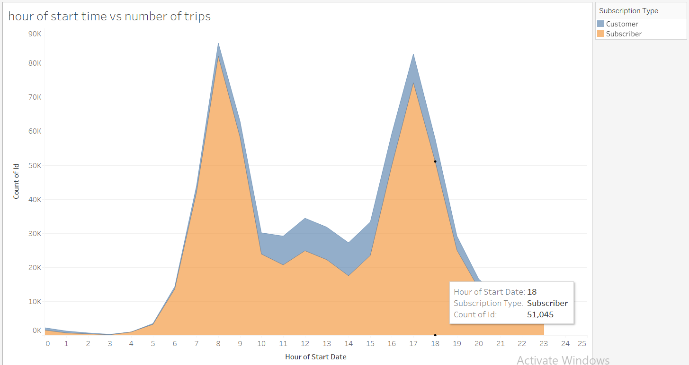
Hours VS No of Trips

Slide 7
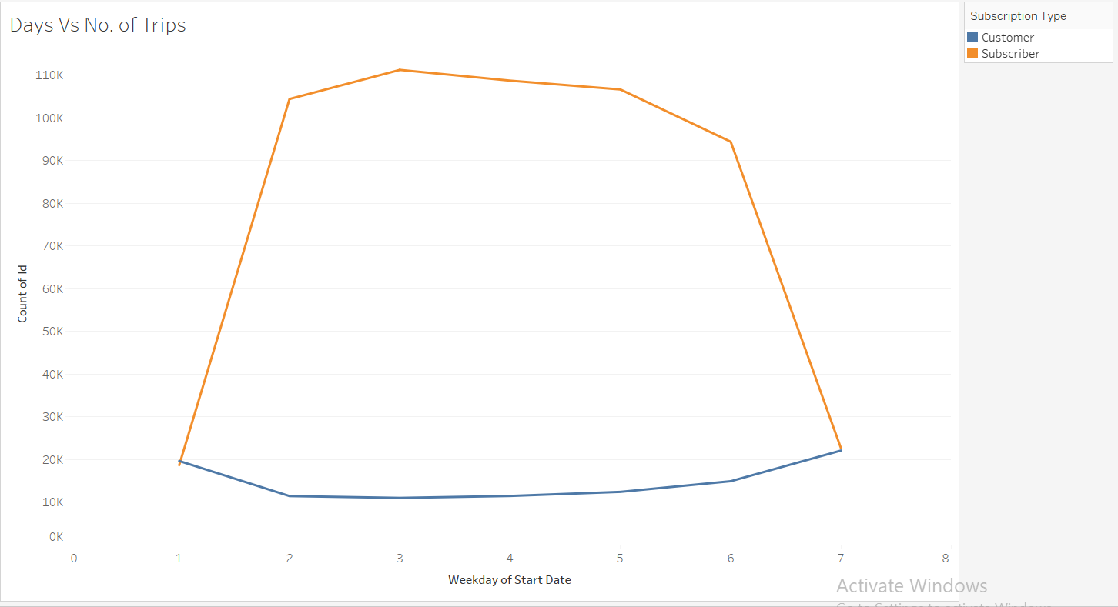
Week days VS No of Trips

Slide 8
Conclusion(Task 4)
The idea of couple bikes would both help the company and at the same time could bring a lot of challenges. The main factor to consider is that our customers are mainly travelling on weekdays and on office times that means our customers are mainly office workers and generally office workers don’t prefer taking couple bikes. Rather they prefer their commute alone. If the company wants to introduce couple bikes, then it is highly possible that the existing customers would be divided. We can not keep the charges more than double the price of individual bike. That would totally fail the motive of introducing a couple bike.
These are the factors that we have to consider while introducing couple bikes in our company.

